Slide 1
Intro to Relational Database Development with SQL Server

Slide 2
Overview
What is a relational database and why should I care?

Slide 3
Client/Server Systems
Almost all applications depend on a database system.
Building a well-designed database allows you to be flexible to future changes and a you code to be performant
Clients – personal computers, mobile devices or tablets that consume data directly or indirectly though application server
Servers – machines that provide functionality and data to clients
types of servers: database servers, application servers, web servers, etc

Slide 4
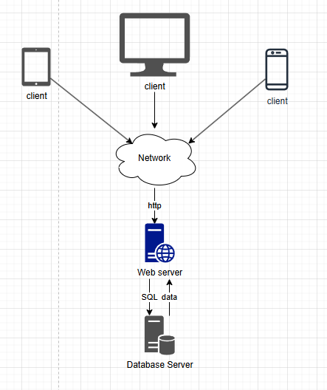
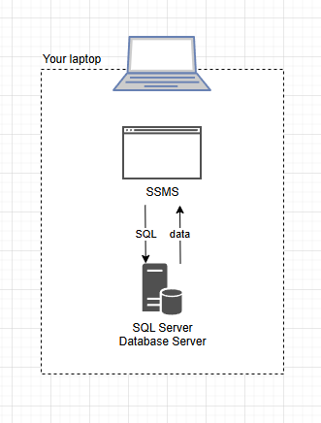
Simple Client/Server System

Slide 5
We are going to need a theme.
And it can’t be accounts receivable unless you want a nap.

Slide 6
National Dodgeball League
“If you can dodge a wrench, you can dodge a ball.”

Slide 7
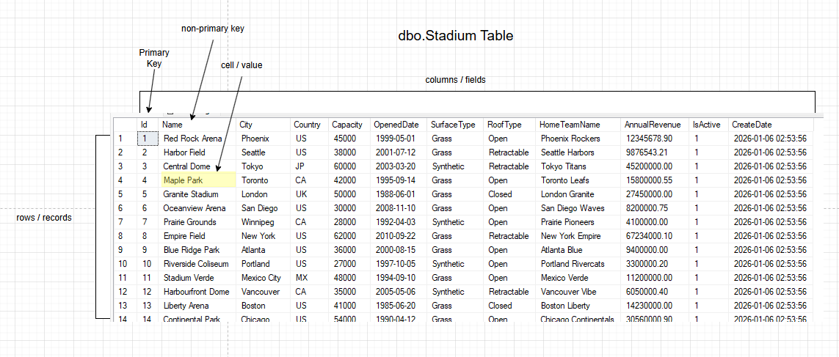
The Mighty Table
Table – usually represents a real world entity
Column – represents a property of an entity
Row – represents an instance of and entity
Primary key – uniquely identifies a row
Non-primary key / unique keys – also uniquely identifies a row but as a secondary concern.

Slide 8
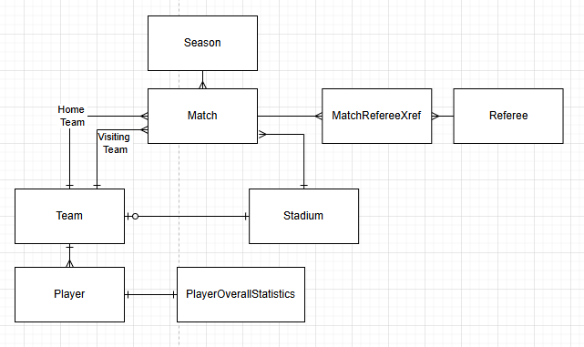
Relationships
One-to-one – two tables with properties related to one entity; not very common; Also referred to as a segmentation table.
One-to-many – One table is the main unifying table, or parent table, while the other table is a child that can have zero or more related sub entities. This is the most commonly used relationship.
Many-to-many – This relationship allows many rows from one table to relate to many rows in a related table. Neither is hierarchically higher than the other. This is often implemented with three tables, two master entity tables and one middle mapping table, or cross reference table. The Match table is and example of this. On the left side you can see team having many matches and on the right-hand side, stadiums can be used in many matches.

Slide 9
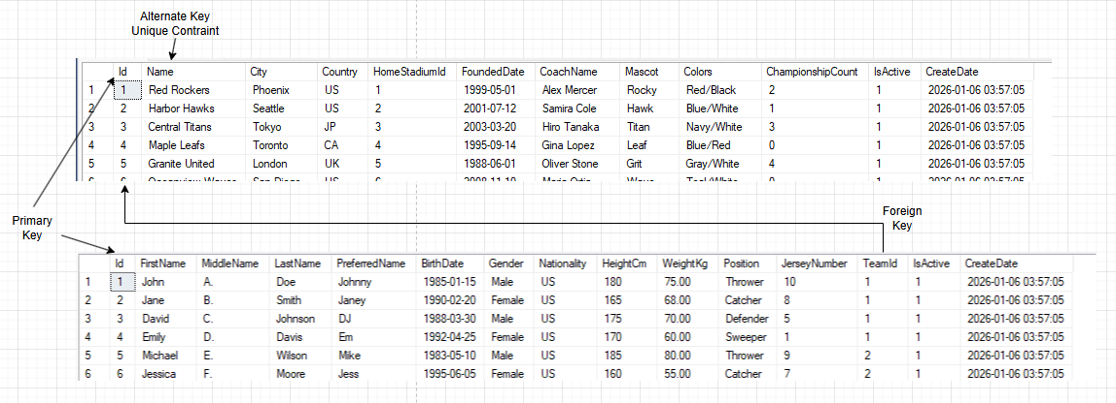
Keys
Primary Key – uniquely identifies each row in the table
Foreign Key – identifies a related row in another table
Alternate Key – alternate identifier that uniquely identifies each row in the table
Composite key – A key made up of more than one field. This is defined as a unique constraint and not usually used in relationships.

Slide 10
Columns
Data types – defines what kind of value a column can store. Examples: INT → whole numbers
VARCHAR(100) → text
DATE → calendar dates
BIT → true/false
Default value – A default value is the value SQL Server automatically uses when no value is provided during an insert. Example: IsActive BIT DEFAULT (1)
Nullability – indicates of a field can be null, aka unknown. Example: HomeTeamName VARCHAR(100) NULL
Identity - column is a SQL Server column that automatically generates a numeric value for each new row, typically used for primary keys. Example: INT IDENTITY(1,1)
Identity Seed - The starting value for an IDENTITY column — the first number generated.
Identify Increment - The amount added to the previous value for each new row.

Slide 11
Common SQL Server Data Types
Type | Description
bit | A value of 1 or 0 that represents a True or False value
int, bigint, smallint | Integer values of various sizes
money, smallmoney | Monetary values that are accurate to the last significant digit
decimal, numeric | Decimal values that are accurate to four decimal places.
float, real | Floating-point values that contain an approximation of the decimal value
date, time, datetime2 | Dates and Times
char, varchar | A string of letters, symbols, and numbers of the ASCII character set.
nchar, nvarchar | A string of letters, symbols, and numbers of the Unicode character set.

Slide 12
History of SQL
1970 Theory was formulated by Dr E. F. Cobb
1978 IBM created first implementation
1989 first ANSI standard created
1992 ANSI standard update
Six more ANSI standard updates occurred. 1999, 2003, 2006,2008, 2011, 2016
2019 ANSI SQL-2019 published

Slide 13








What Else Will You Know

Slide 14
SQL – Structured Query Language
SQL is the language we use to communication with SQL Server to create database objects like tables, views, functions and stored procedures.
SQL is broken out into two parts DDL and DML
DML – Data Manipulation Language
DDL – Data Definition Language
Type | Description
SELECT | Retrieves data from one or more tables.
INSERT | Adds one or more new rows.
UPDATE | Changes one or more existing rows in a table.
DELETE | Deletes one or more existing rows from a table.
Type | Description
CREATE DATABASE | Creates a new database
CREATE TABLE | Creates a new table.
CREATE INDEX | Creates a new index
DELETE | Deletes one or more existing rows from a table.
ALTER TABLE | Changes the structure of an existing table.
ALTER INDEX | Changes the structure of and existing Index.
DROP DATABASE | Deletes existing database.
DROP TABLE | Deletes existing table.
DROP INDEX | Deletes existing index.

Slide 15
DDL – Create Database
CREATE DATABASE Dodegeball;
Try it.
Create your first Database.
Too easy right?

Slide 16
DDL – Create Table
CREATE TABLE dbo.Player
(
Id INT IDENTITY(1,1) NOT NULL CONSTRAINT PK_Player PRIMARY KEY,
FirstName VARCHAR(100) NOT NULL,
MiddleName VARCHAR(50) NULL,
LastName VARCHAR(100) NOT NULL,
PreferredName VARCHAR(100) NULL,
BirthDate DATE NULL,
Gender VARCHAR(20) NULL,
Nationality VARCHAR(50) NULL,
HeightCm SMALLINT NULL,
WeightKg DECIMAL(5,2) NULL,
Position VARCHAR(50) NULL,
JerseyNumber TINYINT NULL,
TeamId INT NULL,
IsActive BIT NOT NULL CONSTRAINT DF_Player_IsActive DEFAULT (1),
CreateDate DATETIME2(0) NOT NULL CONSTRAINT DF_Player_CreateDate DEFAULT (SYSUTCDATETIME()),
CONSTRAINT FK_Player_Team FOREIGN KEY (TeamId) REFERENCES dbo.Team(Id)
);

Slide 17
DDL – Create Table – Your Turn
Try it.
Create your first table using SQL. Let’s make it super simple.
CREATE TABLE dbo.StateLookup
(
Id INT IDENTITY(1,1) NOT NULL CONSTRAINT PK_StateLookup PRIMARY KEY,
Code CHAR(2) NOT NULL,
Description VARCHAR(50) NOT NULL
)

Slide 18
DDL – Alter Table and Create Index
Try it.
Add a column to an existing table.
Confirm it worked.
Delete it.
Confirm again
Add and index.
What does an index do again?
ALTER TABLE StateLookup
ADD Capital varchar(50) NULL;
ALTER TABLE StateLookup
DROP COLUMN Capital;
CREATE INDEX IX_StateLookup_Name
ON Stadium (Code);

Slide 19
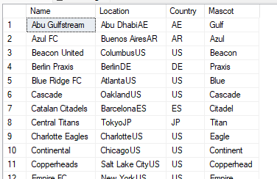
How to Query a Single Table
SELECT – specifies what fields to return
FROM – specifies the base table to return the data from
WHERE – define criteria used to filter from available table rows
ORDER BY – used to sort the results
Example:
SELECT Name,
City + Country AS Location,
Country,
Mascot
FROM Team
WHERE IsActive = 1
ORDER BY Name

Slide 20
How to join data from two or more tables
INNER JOIN – Returns rows where both tables match.
  SELECT *
  FROM Stadium s
  INNER JOIN Team t ON t.StadiumId = s.Id;
LEFT [OUTER] JOIN – Returns all rows from the left table, plus matches from the right table.Unmatched right-side rows return NULL.
  SELECT *
  FROM Stadium s
  LEFT JOIN Team t ON t.StadiumId = s.Id;
RIGHT [OUTER] JOIN - Returns all rows from the right table, plus matches from the left.
  SELECT *
  FROM Team t
  RIGHT JOIN Stadium s ON t.StadiumID = s.StadiumID;
FULL OUTER JOIN – Returns all rows from both tables, matched where possible.
  SELECT *
  FROM Team t
  FULL OUTER JOIN Stadium s ON t.StadiumID = s.StadiumID;
CROSS JOIN - Returns every combination of rows.
  SELECT *
  FROM Team
  CROSS JOIN Stadium;
SELF JOIN - A table joined to itself.
  SELECT *
  FROM Employee e1
  JOIN Employee e2 ON e1.ManagerID = e2.EmployeeID;

Slide 21
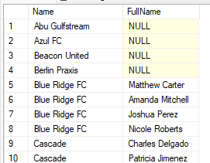
Join Example
SELECT t.Name,
p.FirstName + ' ' + p.LastName as FullName
FROM dbo.Team t
LEFT JOIN dbo.Player p ON p.TeamId = t.Id
ORDER BY t.Name;

Slide 22
Insert a new row
INSERT INTO dbo.Team (Name, City,
Country,
HomeStadiumId,
FoundedDate,
CoachName,
Mascot,
Colors,
ChampionshipCount,
IsActive)
VALUES ('Red Rockers’,
'Phoenix’,
'US’,
1,
'1999-05-01’,
'Alex Mercer’,
'Rocky’,
'Red/Black’,
2,
1)

Slide 23
Update row
UPDATE Player
SET LastName = ‘Jones’
WHERE Id = 26;

Slide 24
Delete a Row
DELETE FROM Player
WHERE Id = 26;

Slide 25
Comments
Line Comment
-- Two dashes before every line comment out that single line
Block Comment
/*
Sometimes we need to have very lengthy descriptions that
Take up many lines.
So many lines that have dashes
*/

Slide 26
SQL Server Management Studio

Slide 27
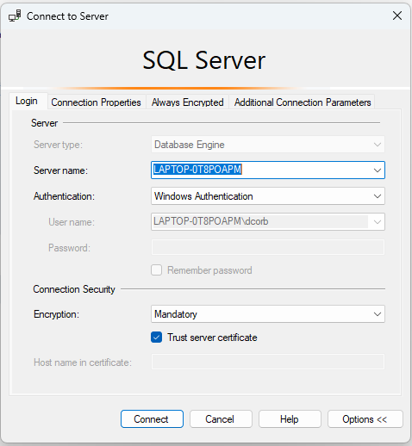
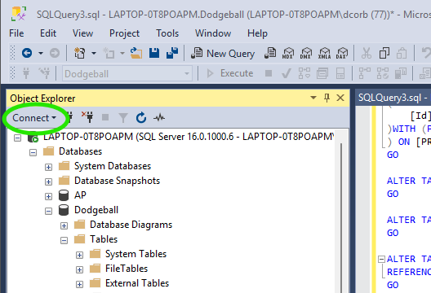
How to Connect to Database Server

Slide 28
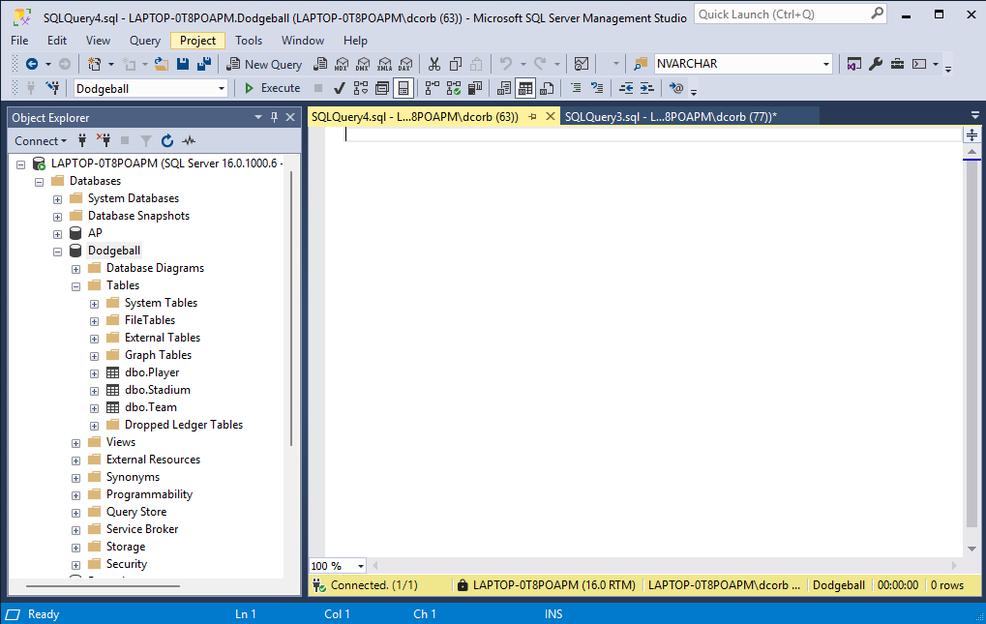
Navigating with SSMS

Slide 29
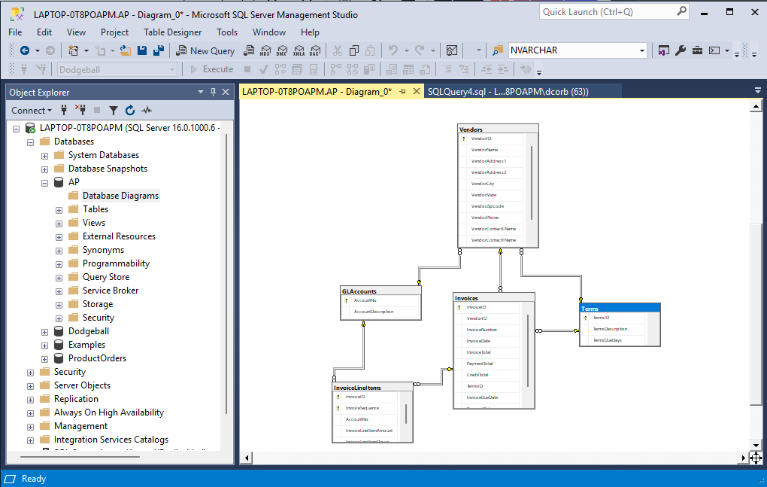
Entity Relationship Diagrams (ERD)
Try it.
Create your first diagram like this.

Slide 30
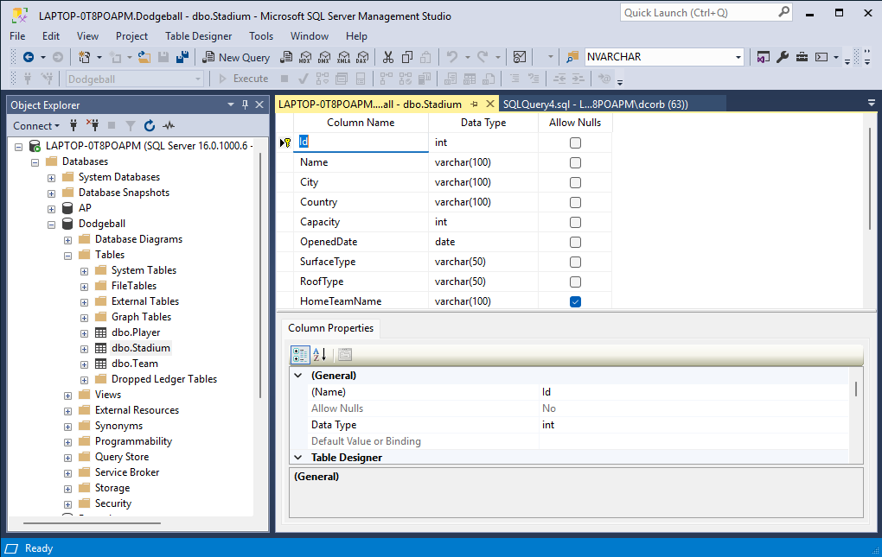
Column Definitions of A Table
Try it.
1. Open the table designer for the table Stadium and look around.
2. Create a new table called “Coach” with fields:
Id
FirstName
LastName
JerseyNumber
ExperienceInYears
HomeCity
HomeCountry
CreateDate

Slide 31
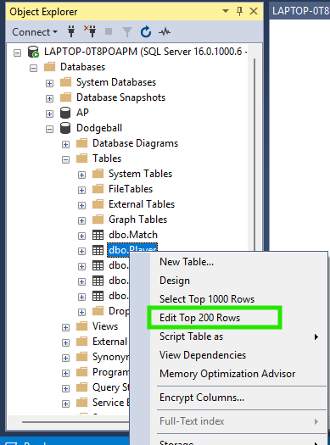
One Way to Edit Data
Advice.
This is fine for starting out but do get used to updating data using SQL.

Slide 32
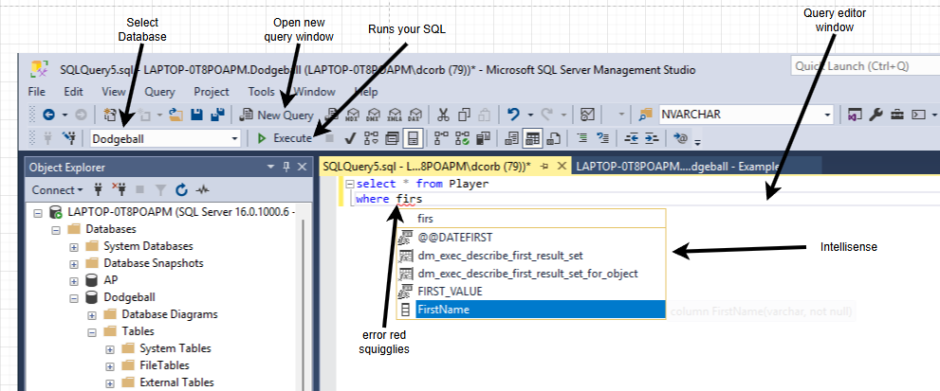
Some Key Functions in SSMS

Slide 33

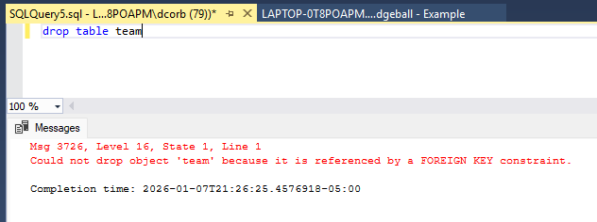
Error Types
Design time errors
Are presented in the red squigglies
Run-time errors
Appear in the result pane.
Why did this happen?
Any guesses?

Slide 34
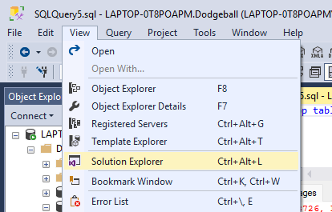
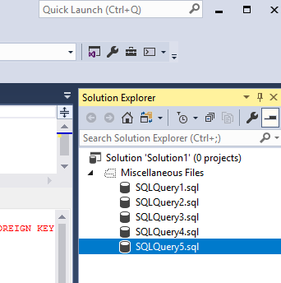
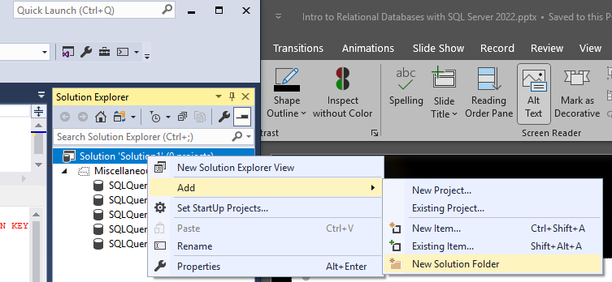
Saving Queries
CTRL+S – saves the current file
CTRL+O – opens a file
Q. Where should we save these files?
A. That will depend on your preferences. I create a development folder called “c:\repos” and then create subfolders for each project underneath that. Then I create a solution to make all your files visible from within SSMS.

Slide 35
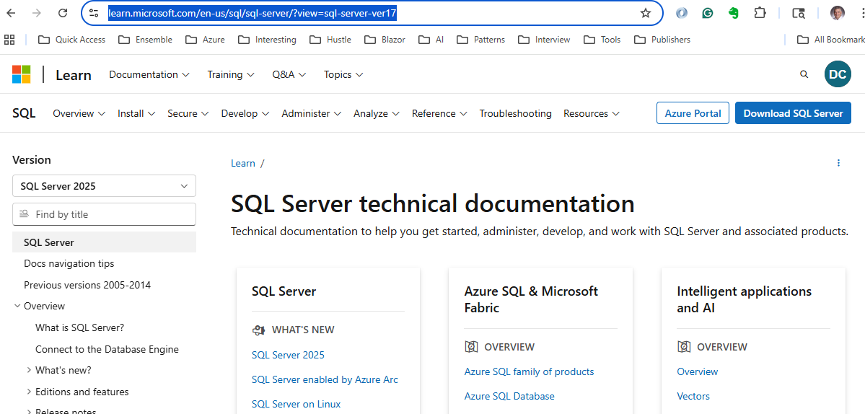
How to get more help
https://learn.microsoft.com/en-us/sql/sql-server

Slide 36
More on Retrieving Data from a Single Table

Slide 37
Basic Select
Clauses:
SELECT – specifies what fields to return
FROM – specifies the base table to return the data from
WHERE – define criteria used to filter from available table rows
ORDER BY – used to sort the results
Examples:
SELECT * FROM Teams
SELECT Name, City, Country FROM Teams
SELECT PlayerId,
PlayersEliminated / GamesPlayed AS EliminationsPerGame
FROM PlayerOverallStatistics
SELECT * FROM Match WHERE MatchDate BETWEEN '2025-09-04’ AND '2025-09-07’
SELECT PlayerId,
PlayersEliminated / GamesPlayed AS EliminationsPerGame , *
FROM PlayerOverallStatistics
WHERE FoulsCommitted > 10
New Keywords:
BETWEEN – supports range queries
Guidelines:
Avoid * for performance reasons
Concatenation of fields are referred to as expressions

Slide 38
Practice Time
Try it.
Write a query that retrieves the FirstName, LastName, and Position for every player in the Player table

Slide 39
Practice Time
Try it.
List the Name and Capacity of all stadiums in the Stadium table that have a Capacity greater than or equal to 50,000.

Slide 40
Expanded SELECT Syntax
Clauses:
SELECT [ALLIDISTINCT] [TOP n [PERCENT] [WITH TIES]]
column_specification [[AS] result_column]
[, column_specification _[ [AS] result_column]]
Examples:
SELECT DISTINCT Name, City + ‘, ‘ + Country as [Home Location] FROM Teams
SELECT PlayerId,
PlayersEliminated / GamesPlayed
FROM PlayerOverallStatistics
-- Get top 5 teams by championship count, including ties
SELECT TOP 5 WITH TIES
Name,
ChampionshipCount
FROM dbo.Team
ORDER BY ChampionshipCount DESC;
SELECT TOP 10 PERCENT Name, ChampionshipCount
FROM dbo.Team
ORDER BY ChampionshipCount DESC;
New Keywords:
ALL – never used as it is the default behavior
DISTINCT – removes duplicate rows from a query result, returning only unique values
TOP – specifies the number of rows to return
PERCENT – specifies the percent of table rows to return
WITH TIES - used with the TOP clause to include additional rows that have the same value in the ORDER BY column(s) as the last row in the result set.
AS – used for aliasing column names
New Functions:
GETDATE() – gets the current date in the timezone the server results.
GETUTCDATE() – gets the current time from Greenwich England. Also known as UTC or Coordinated Universal Time.
Guidelines:
Avoid * for performance reasons
Concatenation of fields are referred to as expressions

Slide 41
Practice Time
Try it.
Find the top 5 teams with the most championships. Retrieve the Name and ChampionshipCount, and sort the results from the highest number of championships to the lowest.

Slide 42
Arithmatic Details
Operators in order of precedence:
* Multiplication
/ Division
% Modulo (Remainder)
+ Addition
- Subtraction
Parentheses matter
Examples:
SELECT InvoiceID,
  InvoiceID + 7 * 3 AS OrderOfPrecedence,
  (InvoiceID + 7} * 3 AS AddFirst
FROM Invoices
ORDER BY InvoiceID
SELECT InvoiceID,
  InvoiceID / 10 AS Quotient,
  InvoiceID % 10 AS Remainder
FROM Invoices
ORDER BY InvoiceID;

Slide 43
Practice Time
Try it.
For each stadium, calculate the annual profit by subtracting the AnnualOperatingCost from the AnnualRevenue. Name the new column AnnualProfit. Include the stadium Name in your results.

Slide 44
Functions
LEFT – get the leftmost portion of a string
CONVERT – changes a value of one data type into another data type
GETDATE - gets the current date in the timezone the server results.
DATEDIFF – determines the difference between two dates using the unit of measure specified
Example:
SELECT Id,
FirstName,
LastName,
LEFT(FirstName, 1) AS FirstInitial,
LEFT(LastName, 3) AS LastNamePrefix,
BirthDate,
GETDATE() AS CurrentDateTime,
DATEDIFF(YEAR, BirthDate, GETDATE()) AS ApproximateAge,
DATEDIFF(DAY, BirthDate, GETDATE()) AS DaysOld,
DATEDIFF(MONTH, BirthDate, GETDATE()) AS MonthsOld
FROM dbo.Player
WHERE TeamId = 1
ORDER BY BirthDate;

Slide 45
Basic WHERE Clause
Comparison Operators
= Equal
> Greater than
< Less than
<= Less than or equal to
>= Greater than or equal to
<> Not equal
Examples:
WHERE Country = ‘US’
Profitable stadiums
WHERE AnnualRevenue - AnnualOperatingCost > 0
Teams with names from A to L
WHERE Name < 'M’
Stadium on or before a specified date,
WHERE OpenedDate <= '2003-03-20’
Team with Championship titles
WHERE ChampionshipCount <> 0

Slide 46
Basic WHERE Clause
Examples:
-- Team from US and coach Samira Cole, or coach name Ellen Park in any country. Common mistake.
SELECT * FROM Team
WHERE Country = 'US' AND
CoachName = 'Samira Cole' OR
CoachName = 'Ellen Park’
-- Team from US and coach Samira Cole or Ellen Park. Common mistake corrected.
SELECT * FROM Team
WHERE Country = 'US' AND
(CoachName = 'Samira Cole' OR
CoachName = 'Ellen Park’)
-- Team from US but not coached by Samira Cole or Ellen Park. Common mistake corrected.
SELECT * FROM Team
WHERE Country = 'US' AND
NOT (CoachName = 'Samira Cole' OR
CoachName = 'Ellen Park’)
Keywords
AND
OR
NOT
Parentheses

Slide 47
Practice Time
Try it.
Create a result set that shows a single column named PlayerDetails. This column should combine the FirstName and LastName with a space in between (e.g., "John Doe"). Only include players whose Nationality is 'US'.

Slide 48
Practice Time
Try it.
Retrieve the Name and CoachName of all teams from the Team table that are located in the 'US' and have won more than 2 championships.

Slide 49
Basic WHERE Clause
Examples:
-- Team from US or Japan
SELECT * FROM Team
WHERE Country IN ('US', 'JP’)
SELECT MatchDate, HomeTeamId, AwayTeamId
FROM dbo.Match
WHERE MatchDate BETWEEN '2025-09-01' AND '2025-09-30’;
Keywords
IN - allows you to specify multiple values in a WHERE condition, checking if a column's value matches any value in a list.
BETWEEN - filters results to include values within a specified range (inclusive of both endpoints)
Guidelines:
Be aware that using BETWEEN with Dates can have a challenge in that the end date will not include times. For instance, in the example to the right a Match with a MatchDate of 9/30/2025 03:00:00 PM will not be contained within the date range. If you want to include that time then you have a couple of options. You can use the next date, ‘2025-10-01’, which is basically midnight. Or you can include time in the range. That would look like ‘2025-09-30 23:59:59.999’

Slide 50
Practice Time
Try it.
Write a query to find all players who play in the positions of 'Thrower', 'Catcher', or 'Sweeper'. Sort the results by LastName.

Slide 51
Basic WHERE Clause
Wildcards symbols
Examples:
WHERE City LIKE 'Va%’ -- Vancouver
WHERE City LIKE 'L_s%' -- Los Angeles and Lisbon
WHERE country like 'U[A-K]' -- UK
WHERE country like 'U[^A-K]' -- US
Symbol | Description
% | Matches any string of zero or more character
_ | Matches any single character.
[ ] | Matches a single character listed withing the brackets.
[ - ] | Matches a single character within the given range.
[ ^ ] | Matches a single character not listed after the caret.

Slide 52
Practice Time
Try it.
Find all teams whose names start with the word 'Harbor'. Use the appropriate wildcard to ensure any characters following 'Harbor' are included.

Slide 53
Basic WHERE Clause
Examples:
-- List player with unknown birth date
select * from Player where BirthDate is NULL
-- List player with only known birth date
select * from Player where BirthDate is NOT NULL
Keywords
NULL – used to represent unknown data

Slide 54
Practice Time
Try it.
Identify players who do not have a middle name listed in the database. Retrieve their FirstName and LastName where the MiddleName is NULL.

Slide 55
ORDER BY Clause
Examples:
SELECT Name,
City,
Capacity,
AnnualRevenue,
AnnualOperatingCost,
(AnnualRevenue - AnnualOperatingCost) AS NetIncome
FROM dbo.Stadium
WHERE IsActive = 1
ORDER BY Capacity DESC, Name ASC
OFFSET 5 ROWS
FETCH NEXT 8 ROWS ONLY;
Keywords
ORDER BY – used to represent unknown data
ASC – ascending order
DESC – descending order
OFFSET – in sorted results, OFFSET is the number of rows to be skipped before selecting rows to be returned . Often used in pagination.
FETCH – The number of rows to be returned. Often used in pagination.

Slide 56
Practice Time
Exercise: Stadium Capacity Paging
Scenario: You are building a mobile app for Dodgeball fans. The app displays a list of stadiums, but the screen is small, so you can only show 5 stadiums at a time. You need to retrieve the second page of the list.
The Task: Write a query that retrieves the Name, City, and Capacity of all stadiums from the Stadium table.
1. Sort the result set by Capacity in descending order (largest stadiums first).
2. Skip the first 5 rows (the first page).
3. Retrieve the next 5 rows (the second page).

Slide 57
Working with Multiple Tables
More to come

Slide 58
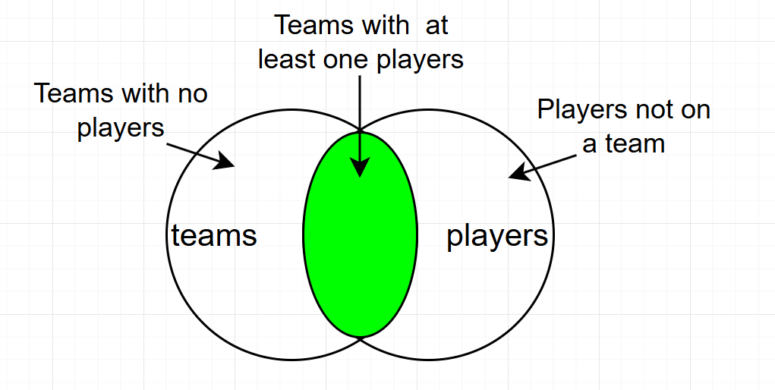
INNER JOINS
INNER JOINs are the second most common type of joins used. They return rows from both tables where the join conditions are met.

Slide 59
Inner Join Example
-- Top 20 players by total points with their team info
SELECT TOP 20 p.FirstName,
p.LastName,
t.Name AS TeamName,
pos.TotalPoints,
pos.GamesPlayed,
pos.SuccessfulHits,
pos.TotalCatches,
FROM dbo.Player p
INNER JOIN dbo.Team t ON p.TeamId = t.Id
INNER JOIN dbo.PlayerOverallStatistics pos ON p.Id = pos.PlayerId
ORDER BY pos.TotalPoints DESC;

Slide 60
Practice Time
Try it.
Get players with their team and stadium information.

Slide 61
Compound Joins and Self-Joins
With compound joins you can include two or more comparisons in a join condition using the AND and 0R operators.
A self-join joins a table with itself.
-- Find veteran and rookie pairings on same team
SELECT pv.FirstName + ' ' + pv.LastName AS Veteran,
pr.FirstName + ' ' + pr.LastName AS Rookie,
t.Name AS Team,
DATEDIFF(YEAR, pv.BirthDate, GETDATE()) AS VeteranAge,
DATEDIFF(YEAR, pr.BirthDate, GETDATE()) AS RookieAge
FROM dbo.Player pv
INNER JOIN dbo.Player pr ON pv.TeamId = pr.TeamId AND
pv.Id <> pr.Id AND
DATEDIFF(YEAR, pv.BirthDate, GETDATE()) >= 39 AND -- Veteran
DATEDIFF(YEAR, pr.BirthDate, GETDATE()) <= 32 -- Younger player
INNER JOIN dbo.Team t ON pv.TeamId = t.Id
WHERE pv.IsActive = 1 AND pr.IsActive = 1
ORDER BY t.Name, VeteranAge DESC;

Slide 62
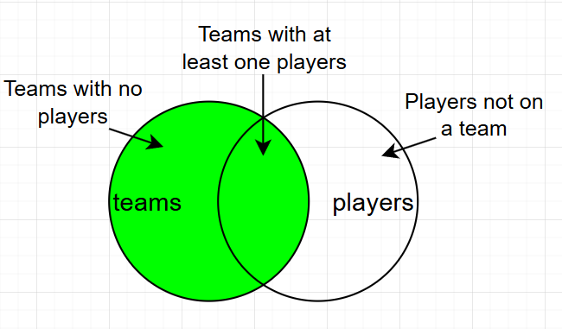
LEFT [OUTER] JOIN
LEFT JOINs are the most common type of joins used. They return all rows from the base table and those rows from the non-base table that match fields in the ON clause.
-- returns all teams and their players as well as teams without players
SELECT t.Name AS TeamName,
t.City,
p.FirstName,
p.LastName,
t.ChampionshipCount
FROM dbo.Team t
LEFT JOIN dbo.Player p ON t.Id = p.TeamId
ORDER BY t.Name, p.LastName;

Slide 63
Practice Time
Scenario:
You are preparing a report for team managers. They want to see ALL teams in the league along with their players. Some teams might not have any players assigned yet, but they still need to appear in the report.
Task 1: Basic Team and Player List
Write a query that shows:
Team name
Team city
Player first name
Player last name
Player position
Important: ALL teams must appear in the results, even if they have no players.
Expected Output:
Teams with players should show their player details. Teams without players should still show the team name and city, with NULL for player columns.
Starter Code:
SELECT t.Name AS TeamName,
t.City,
p.FirstName,
p.LastName,
p.Position
FROM dbo.Team t
-- Complete the query here
ORDER BY t.Name, p.LastName;

Slide 64
Practice Time
Scenario:
You are preparing a report for team managers. They want to see ALL teams in the league along with their players. Some teams might not have any players assigned yet, but they still need to appear in the report.
Task 1: Basic Team and Player List
Write a query that shows:
Team name
Team city
Player first name
Player last name
Player position
Important: ALL teams must appear in the results, even if they have no players.
Expected Output:
Teams with players should show their player details. Teams without players should still show the team name and city, with NULL for player columns.

Slide 65
Practice Time
ANSWER
-- Task 1: Basic Team and Player List
SELECT t.Name AS TeamName,
t.City,
p.FirstName,
p.LastName,
p.Position
FROM dbo.Team t
LEFT JOIN dbo.Player p ON t.Id = p.TeamId
ORDER BY t.Name, p.LastName;

Slide 66
Practice Time
Task 2: Count Players Per Team
Now modify your query to show how many players each team has. Include teams with zero players.
Show:
Team name
Player count
Hint: Use LEFT JOIN with GROUP BY and COUNT()

Slide 67
Practice Time
ANSWER
-- Task 2: Count Players Per Team
SELECT t.Name AS TeamName,
COUNT(p.Id) AS PlayerCount
FROM dbo.Team t
LEFT JOIN dbo.Player p ON t.Id = p.TeamId
GROUP BY t.Name
ORDER BY PlayerCount DESC, t.Name;

Slide 68
Practice Time
Task 3: Find Teams Without Players
Write a query to find teams that don't have ANY players assigned yet.
Show:
Team name
Team city
Coach name
Hint: After the LEFT JOIN, use WHERE to check if the player ID is NULL

Slide 69
Practice Time
ANSWER
-- Task 3: Find Teams Without Players
SELECT t.Name AS TeamName,
t.City,
t.CoachName
FROM dbo.Team t
LEFT JOIN dbo.Player p ON t.Id = p.TeamId
WHERE p.Id IS NULL
ORDER BY t.Name;

Slide 70
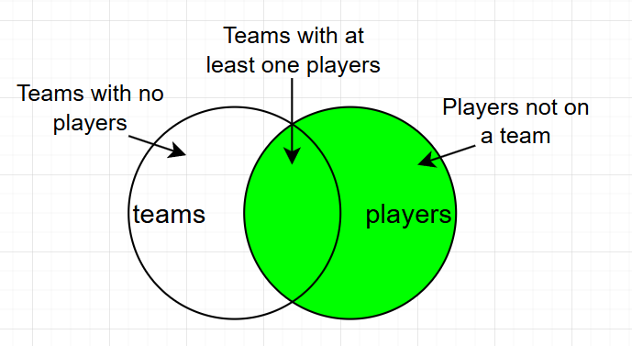
RIGHT [OUTER] JOIN
RIGHT JOINs are seldom, if ever, used. They return all rows from the non-base table and those rows from the base table that match fields in the ON clause.
-- returns all teams and their players as well as teams without players
SELECT t.Name AS TeamName,
t.City,
p.FirstName,
p.LastName,
t.ChampionshipCount
FROM dbo.Team t
RIGHT JOIN dbo.Player p ON t.Id = p.TeamId
ORDER BY t.Name, p.LastName;

Slide 71
FULL [OUTER] JOIN
FULL JOINs are seldom, if ever, used. They return all rows from the base table and all rows from the non-base table where the rows match in the ON clause or not.
-- returns all teams and their players as well as teams without players
SELECT t.Name AS TeamName,
t.City,
p.FirstName,
p.LastName,
t.ChampionshipCount
FROM dbo.Team t
FULL JOIN dbo.Player p ON t.Id = p.TeamId
ORDER BY t.Name, p.LastName;

Slide 72
CROSS JOIN
CROSS JOINs are seldom, if ever, used. Their main use case is for creating seed test data. They return every combination of base table and non-base tables irrespective rows matching or not.
Assume two tables in question are being cross joined and they both have 100 roes, the resulting output will have 10,000 rows.
-- returns all teams and their players as well as teams without players
SELECT t.Name AS TeamName,
t.City,
p.FirstName,
p.LastName,
t.ChampionshipCount
FROM dbo.Team t
CROSS JOIN dbo.Player p
ORDER BY t.Name, p.LastName;

Slide 73
UNIONs
A UNION query combines rows from two or more result sets.
For this to work, each SELECT statement must have the same number of columns with the same data type.
By default, duplicates will be removed unless you use “UNION ALL”
-- Get unique list of all cities from both teams and stadiums
SELECT DISTINCT City, 'Team' AS Source
FROM dbo.Team
UNION
SELECT DISTINCT City, 'Stadium' AS Source
FROM dbo.Stadium
ORDER BY City;

Slide 74
EXCEPT and INERSECT
EXCEPT - Returns rows from the first query that are NOT in the second query (set difference)
INTERSECT - Returns only rows that appear in BOTH queries (set intersection)
-- Teams that have NEVER played a home match
SELECT Id FROM dbo.Team
EXCEPT
SELECT DISTINCT HomeTeamId FROM dbo.Match;
-- Teams That Have Players AND Have Played Matches
--
-- Teams with at least one player
SELECT DISTINCT TeamId
FROM dbo.Player
WHERE IsActive = 1
INTERSECT
-- Teams that have played matches
SELECT DISTINCT HomeTeamId
FROM dbo.Match

Slide 75
Summary Queries
COUNT, AVG, SUM oh my!

Slide 76
Aggregate Functions - Keywords
COUNT - Returns the number of items in a group.
AVG - Returns the average of numeric values (ignores NULLs).
MIN - Returns the lowest value in a set.
MAX - Returns the highest value in a set.
GROUP BY - Combines rows that have the same values in specified columns into a single row, allowing you to apply aggregate functions to each group.
HAVING - Filters groups after aggregation
Filters the results of a GROUP BY query based on aggregate function results. It's like WHERE, but for grouped data.

Slide 77
Aggregate Functions - Example
-- Player Performance Summary by Position
SELECT p.Position,
COUNT(p.Id) AS TotalPlayers, -- Total count
COUNT(DISTINCT p.TeamId) AS TeamsWithPosition, -- Distinct teams count
AVG(pos.TotalPoints) AS AvgPoints,
MIN(pos.TotalPoints) AS MinPoints,
MAX(pos.TotalPoints) AS MaxPoints,
SUM(pos.GamesPlayed) AS TotalGamesAllPlayers
FROM dbo.Player p
INNER JOIN dbo.PlayerOverallStatistics pos ON p.Id = pos.PlayerId
WHERE p.IsActive = 1
GROUP BY p.Position
HAVING COUNT(p.Id) >= 10 AND -- Positions with 10+ players
AVG(pos.TotalPoints) >= 350 -- Average over 350 points
ORDER BY AvgPoints DESC;

Slide 78
WHERE vs HAVING
WHERE filters individual rows BEFORE grouping (can't use aggregate functions)
HAVING filters groups AFTER aggregation (can use aggregate functions like COUNT, AVG, SUM)

Slide 79
Practice Time
Task:
Write a query that counts how many players are on each team.
Show:
Team name
Number of players
Show ONLY teams that have more than 3 players.
Sort by player count (highest first).

Slide 80
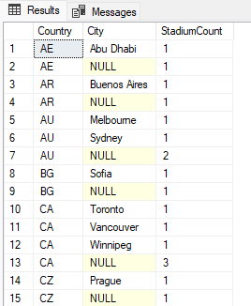
ROLLUP operator
ROLLUP is a GROUP BY extension that creates subtotals and grand totals for hierarchical data.
Syntax:
GROUP BY ROLLUP(column1, column2, column3)
Demo this!
SELECT Country,
City,
COUNT(*) AS StadiumCount
FROM dbo.Stadium
GROUP BY ROLLUP(Country, City);

Slide 81
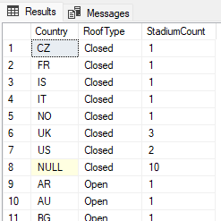
CUBE operator
CUBE is a GROUP BY extension that creates all possible combinations of subtotals for the specified columns.
Syntax:
GROUP BY CUBE(column1, column2, column3)
Demo this!
SELECT Country,
RoofType,
COUNT(*) AS StadiumCount
FROM dbo.Stadium
GROUP BY CUBE(Country, RoofType);

Slide 82
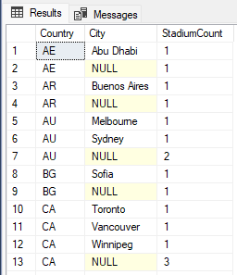
GROUPING SETS operator
GROUPING SETS allows you to define specific grouping combinations in a single query, giving you precise control over which subtotals to generate.
Syntax:
GROUP BY GROUPING SETS (
(column1, column2),
(column1),
()
)
Demo this!
SELECT Country,
City,
COUNT(*) AS StadiumCount
FROM dbo.Stadium
GROUP BY GROUPING SETS (
(Country, City), -- Each city in each country
(Country), -- Country totals
() -- Grand total
);

Slide 83
GROUPING SETS operator
GROUPING SETS allows you to define specific grouping combinations in a single query, giving you precise control over which subtotals to generate.
Syntax:
GROUP BY GROUPING SETS (
(column1, column2),
(column1),
()
)
Demo this!
SELECT Country,
City,
COUNT(*) AS StadiumCount
FROM dbo.Stadium
GROUP BY GROUPING SETS (
(Country, City), -- Each city in each country
(Country), -- Country totals
() -- Grand total
);

Slide 84
OVER Clause
OVER Performs aggregate or ranking calculations over a "window" of rows while keeping all individual rows in the result set (unlike GROUP BY which collapses rows).
-- Add total player count to every row without GROUP BY
SELECT FirstName,
LastName,
TeamId,
COUNT(*) OVER () AS TotalPlayers
FROM dbo.Player;
-- Count players per team, showing on each player row
SELECT p.FirstName,
p.LastName,
t.Name AS TeamName,
COUNT(*) OVER (PARTITION BY p.TeamId) AS TeamPlayerCount
FROM dbo.Player p
JOIN dbo.Team t ON p.TeamId = t.Id
ORDER BY t.Name, p.LastName;
Demo this!

Slide 85
OVER Clause – part 2
ROW_NUMBER - Numbers rows starting from 1, with no gaps or ties, based on the specified ORDER BY clause.
SELECT
t.Name AS TeamName,
p.FirstName + ' ' + p.LastName AS PlayerName,
pos.TotalPoints,
ROW_NUMBER() OVER (
PARTITION BY t.Id -- Separate ranking per team
ORDER BY pos.TotalPoints DESC -- Ranked by points
) AS TeamRank
FROM dbo.Player p
JOIN dbo.Team t ON p.TeamId = t.Id
JOIN dbo.PlayerOverallStatistics pos ON p.Id = pos.PlayerId
ORDER BY t.Name, TeamRank;
Demo this!

Slide 86
Subqueries
Anything tables can do can be replaced by an inner query.

Slide 87
IN Operator
IN - operator tests if a value matches any value in a list or subquery.
NOT IN - operator tests if a value is not included in a list or subquery.
-- Find stadiums in specific countries
SELECT Name, City, Country
FROM dbo.Stadium
WHERE Country IN ('US', 'CA', 'UK’);
-- Find teams that have played matches
SELECT Name
FROM dbo.Team
WHERE Id IN (SELECT DISTINCT HomeTeamId
FROM dbo.Match);

Slide 88
Two Ways to Solve a Problem
IN - operator tests if a value matches any value in a list or subquery.
NOT IN - operator tests if a value is not included in a list or subquery.
-- Find teams that have played matches
SELECT Name
FROM dbo.Team
WHERE Id IN (SELECT DISTINCT HomeTeamId
FROM dbo.Match);
-- Find teams that have played matches (using JOIN)
SELECT DISTINCT t.Name
FROM dbo.Team t
INNER JOIN dbo.Match m ON t.Id = m.HomeTeamId;

Slide 89
Subquery in Comparison
IN - operator tests if a value matches any value in a list or subquery.
NOT IN - operator tests if a value is not included in a list or subquery.
-- Stadiums with above-average capacity
SELECT Name,
City,
Capacity
FROM dbo.Stadium
WHERE Capacity > (SELECT AVG(Capacity)
FROM dbo.Stadium)
ORDER BY Capacity DESC;

Slide 90
ALL, ANY and SOME Operators
ANY and ALL are operators used with subqueries to compare a value against a set of values returned by the subquery.
ANY Operator
Returns TRUE if the comparison is true for at least one value in the subquery result.
ALL (SOME) Operator
Returns TRUE if the comparison is true for every value in the subquery result.
-- Stadiums with capacity greater than any US stadium
SELECT Name,
City,
Capacity
FROM dbo.Stadium
WHERE Capacity > ANY (SELECT Capacity
FROM dbo.Stadium
WHERE Country = 'US');

Slide 91
Simple Subqueries
Subqueries are queries that act as tables . The can be used in SELECT, FROM and WHERE clauses
-- Teams with their player counts and championship comparison
SELECT t.Name AS TeamName,
t.ChampionshipCount,
TeamData.PlayerCount,
(SELECT AVG(ChampionshipCount)
FROM dbo.Team) AS AvgChampionships
FROM dbo.Team t
JOIN (SELECT TeamId,
COUNT(*) AS PlayerCount
FROM dbo.Player
GROUP BY TeamId) AS TeamData ON t.Id = TeamData.TeamId
WHERE t.ChampionshipCount > (SELECT AVG(ChampionshipCount)
FROM dbo.Team)
ORDER BY t.ChampionshipCount DESC;

Slide 92
Correlated Subquery
Correlated Subqueries are subqueries that reference columns from the outer query, creating a dependency between the inner and outer queries.
[NOT] EXISTS is an operator that tests whether a subquery returns any rows. Returns TRUE if the subquery produces at least one row, FALSE otherwise.
Syntax:
WHERE EXISTS (subquery)
-- Teams with NO players
SELECT Name,
City
FROM dbo.Team t
WHERE NOT EXISTS (SELECT 1
FROM dbo.Player p
WHERE p.TeamId = t.Id);

Slide 93
Guidelines
Think about what it is you are trying to find. What is the main data source. That is going to be your base table in the FROM clause.
What other data are you wanting to include in the output? They are added by joins.
Keep in mind that you may benefit from using a sub query in place of a table
Decide if you are interested in raw data or an aggregation of that data or a little bit of both.
Consider using pseudocode to describe what you are trying to return. Break it up into small steps and build onto the result.

Slide 94
Common Table Expressions
CTE (Common Table Expression) is a temporary named result set that exists only during the execution of a single query. It's defined using the WITH clause. This is another way to get the same result as a subquery while simplifying the subsequent code.
-- Teams with their player counts and championship comparison (using CTEs, no CROSS JOIN)
WITH TeamData AS (SELECT TeamId,
COUNT(*) AS PlayerCount
FROM dbo.Player
GROUP BY TeamId),
AvgChampionships AS (SELECT AVG(ChampionshipCount) AS AvgChampCount
FROM dbo.Team)
SELECT t.Name AS TeamName,
t.ChampionshipCount,
td.PlayerCount,
(SELECT AvgChampCount FROM AvgChampionships) AS AvgChampionships
FROM dbo.Team t
JOIN TeamData td ON t.Id = td.TeamId
WHERE t.ChampionshipCount > (SELECT AvgChampCount FROM AvgChampionships)
ORDER BY t.ChampionshipCount DESC;

Slide 95
The Rest of CRUD – Create, Update and Delete
Anything tables can do can be replaced by an inner query.

Slide 96
SELECT INTO
SELECT INTO - creates a new table and inserts the result set from a SELECT statement into it in a single operation.
-- Create a new table with top scorers
SELECT p.Id AS PlayerId,
p.FirstName,
p.LastName,
t.Name AS TeamName,
pos.TotalPoints,
pos.SuccessfulHits,
pos.TotalCatches
INTO TopScorers
FROM dbo.Player p
INNER JOIN dbo.Team t ON p.TeamId = t.Id
INNER JOIN dbo.PlayerOverallStatistics pos ON p.Id = pos.PlayerId
WHERE pos.TotalPoints > 500;

Slide 97
INSERT INTO
INSERT INTO is a SQL statement used to add new rows of data to an existing table. Unlike SELECT INTO (which creates a new table), INSERT INTO adds data to a table that already exists.
INSERT INTO dbo.Match (MatchDate,EventStartTime,DurationMinutes,HomeTeamId,AwayTeamId,StadiumId,HomeScore,AwayScore,Status, SeasonId,Notes)
VALUES
-- Cycle 1: 43 ordered pairs on 2025-09-01
(CAST('2025-09-01' AS date), CAST('2025-09-01T19:00:00' AS datetime2), 60, 1,2,1,10,8,'Completed',5,'Seeded match'),
(CAST('2025-09-01' AS date), CAST('2025-09-01T19:00:00' AS datetime2), 60, 2,3,2,11,9,'Completed',5,'Seeded match')

Slide 98
Considerations
DEFAULT is a constraint in SQL Server that specifies an automatic value to be assigned to a column when no value is explicitly provided during an INSERT operation.
NULL in INSERT Statements represents the absence of a value. NULL is not zero, not an empty string, and not a space—it literally means "no data" or "unknown value.“
If you insert a NULL value into a column that is NOU NULL, and error will occur. Even if it has a default value.
If leave the field off the list of fields to be inserted, then the default values will be applied.

Slide 99
UPDATE
UPDATE is a Data Manipulation Language (DML) statement in SQL used to modify existing data in one or more rows of a table. It changes the values of specified columns for rows that match a given condition.
OUTPUT – give access to previous and after update values
-- Update multiple player statistics after a game and show what changed
UPDATE pos
SET pos.GamesPlayed = pos.GamesPlayed + 1,
pos.TotalThrows = pos.TotalThrows + 45,
pos.SuccessfulHits = pos.SuccessfulHits + 12,
pos.TotalCatches = pos.TotalCatches + 8
OUTPUT DELETED.PlayerId,
DELETED.GamesPlayed AS OldGamesPlayed,
INSERTED.GamesPlayed AS NewGamesPlayed,
DELETED.TotalPoints AS OldTotalPoints,FROM dbo.PlayerOverallStatistics pos
FROM dbo.PlayerOverallStatistics pos
INNER JOIN dbo.Player p ON pos.PlayerId = p.Id
INNER JOIN dbo.Team t ON p.TeamId = t.Id
WHERE t.Name = 'Lightning Bolts' AND
p.IsActive = 1;

Slide 100
DELETE
UPDATE is a Data Manipulation Language (DML) statement in SQL used to modify existing data in one or more rows of a table. It changes the values of specified columns for rows that match a given condition.
OUTPUT – give access to previous and after update values
-- Update multiple player statistics after a game and show what changed
UPDATE pos
SET pos.GamesPlayed = pos.GamesPlayed + 1,
pos.TotalThrows = pos.TotalThrows + 45,
pos.SuccessfulHits = pos.SuccessfulHits + 12,
pos.TotalCatches = pos.TotalCatches + 8
OUTPUT DELETED.PlayerId,
DELETED.GamesPlayed AS OldGamesPlayed,
INSERTED.GamesPlayed AS NewGamesPlayed,
DELETED.TotalPoints AS OldTotalPoints,FROM dbo.PlayerOverallStatistics pos
FROM dbo.PlayerOverallStatistics pos
INNER JOIN dbo.Player p ON pos.PlayerId = p.Id
INNER JOIN dbo.Team t ON p.TeamId = t.Id
WHERE t.Name = 'Lightning Bolts' AND
p.IsActive = 1;

Slide 101
UPDATE
-- Update multiple player statistics after a game and show what changed
UPDATE pos
SET pos.GamesPlayed = pos.GamesPlayed + 1,
pos.TotalThrows = pos.TotalThrows + 45,
pos.SuccessfulHits = pos.SuccessfulHits + 12,
pos.TotalCatches = pos.TotalCatches + 8
OUTPUT DELETED.PlayerId,
DELETED.GamesPlayed AS OldGamesPlayed,
INSERTED.GamesPlayed AS NewGamesPlayed,
DELETED.TotalPoints AS OldTotalPoints,FROM dbo.PlayerOverallStatistics pos
FROM dbo.PlayerOverallStatistics pos
INNER JOIN dbo.Player p ON pos.PlayerId = p.Id
INNER JOIN dbo.Team t ON p.TeamId = t.Id
WHERE t.Name = 'Lightning Bolts' AND
p.IsActive = 1;

Slide 102
DELETE
DELETE is a Data Manipulation Language (DML) statement in SQL used to remove one or more rows from a table. Unlike DROP (which removes the entire table structure), DELETE removes data while keeping the table structure intact.
-- Delete players whose teams are not active
DELETE FROM dbo.Player
WHERE TeamId IN (SELECT Id
FROM dbo.Team
WHERE IsActive = 0);

Slide 103
MERGE
MERGE is an advanced Data Manipulation Language (DML) statement in SQL Server that performs INSERT, UPDATE, and/or DELETE operations in a single atomic statement. It synchronizes a target table with a source table based on a join condition, often called "upsert" (update if exists, insert if not).
-- Synchronize player statistics from team data
MERGE INTO dbo.PlayerOverallStatistics AS target
USING (SELECT p.Id AS PlayerId,
t.ChampionshipCount * 50 AS BonusPoints
FROM dbo.Player p
INNER JOIN dbo.Team t ON p.TeamId = t.Id
WHERE p.IsActive = 1) AS source
ON target.PlayerId = source.PlayerId
WHEN MATCHED THEN
UPDATE SET target.TotalPoints = target.TotalPoints + source.BonusPoints
WHEN NOT MATCHED BY TARGET THEN
INSERT (PlayerId, TotalPoints, GamesPlayed, TotalThrows, SuccessfulHits, TotalCatches, TotalDodges, PlayersEliminated, TimesEliminated, BallsPickedUp, AssistsProvided, MinutesPlayed, PowerThrowsAttempted, PowerThrowsSuccessful, TeamSavingCatches, FoulsCommitted)
VALUES (source.PlayerId, source.BonusPoints, 0, 0, 0, 0, 0, 0, 0, 0, 0, 0, 0, 0, 0, 0);

